Slide 1
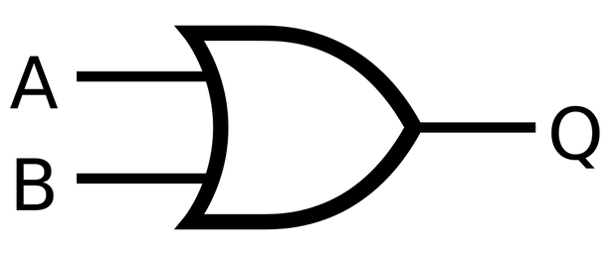


Digital Electronics
Presentation

Slide 2

What will we talk about?
Logic Gate Universal Gate Number System Half-Adar
Full-Adar

Slide 3






Our Team
Dipto 213-15-4321
Anupam 213-15-4306
Moon 213-15-4343
Rajat 213-15-4271
Supto 213-15-4349

Slide 4
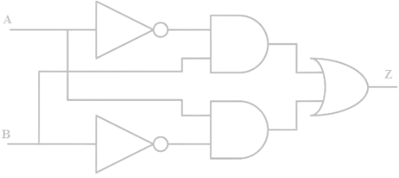

Logic Gate
A logic gate is an electronic component that performs a basic logical operation, such as combining or negating input signals to produce an output signal.

Slide 5

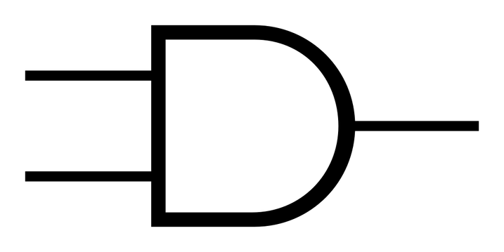

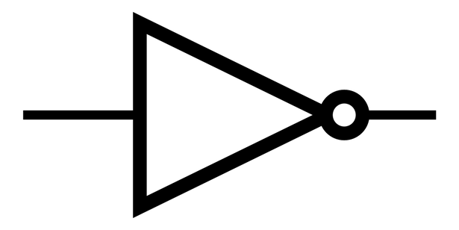
Type Of Logic Gate
3 type-
OR gate
= A+ B
A B
AND gate
Q = AB
NOT gate
A
A̅

Slide 6
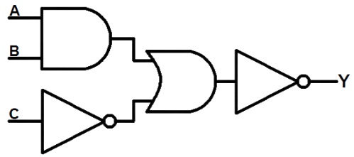

Expression implementaion by
Logic gate
Y = AB+C̅
AB
AB+C̅
= AB+C̅
C̅ ̅

Slide 7
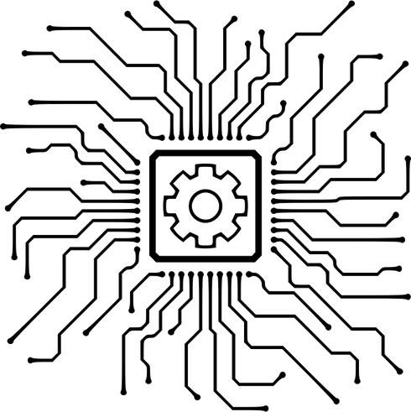
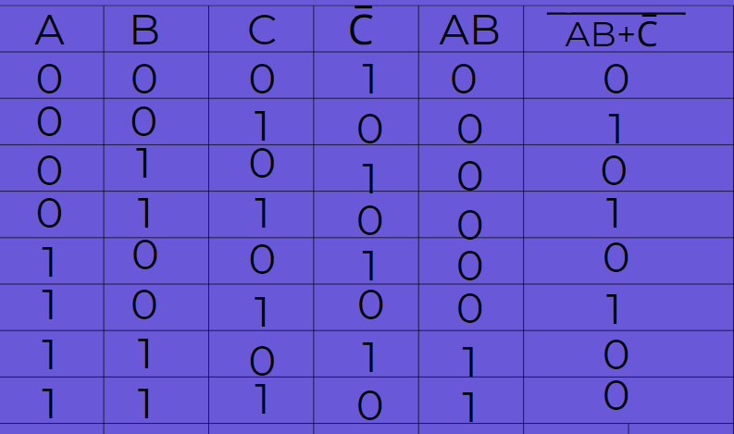


Truth Table
Y = AB+C̅

Slide 8


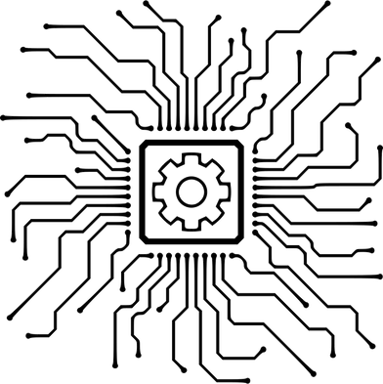



Real life uses of Logic Gate
Boolean Algebra
Digital Electronics
Robotics
Industrial Automation
Communication system

Slide 9




Universal Gate
A universal gate is a special type
of logic gate that can be used to build any other logic gate or perform any logical operation

Slide 10
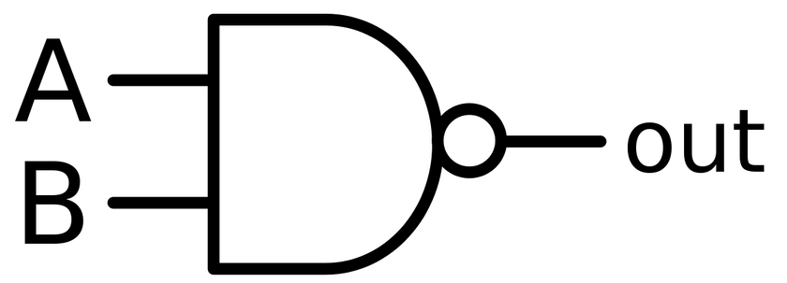

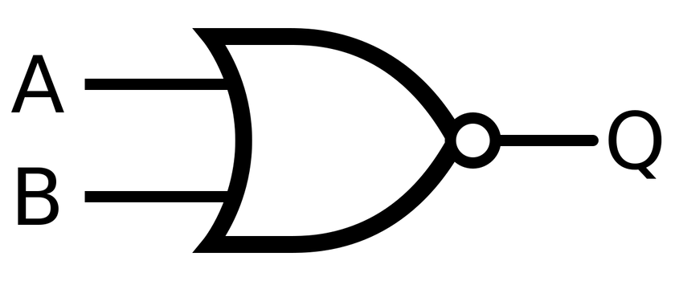
Types of universal gate
Nand gate
Nor gate

Slide 11
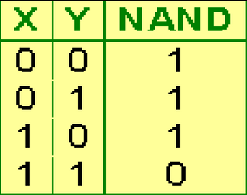

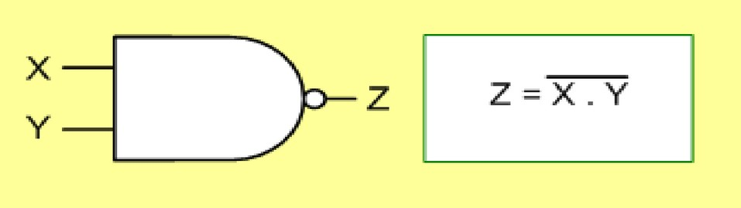
Nand Gate:
The NAND gate represents the complement of the AND operation. Its name is an abbreviation of NOT AND.
The graphic symbol for the NAND gate consists of an AND symbol with a bubble on the output, denoting that a complement operation is performed on the output of the AND gate

Slide 12
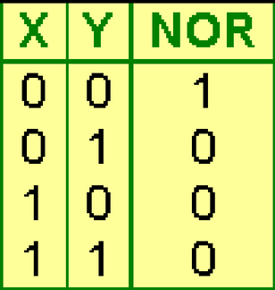
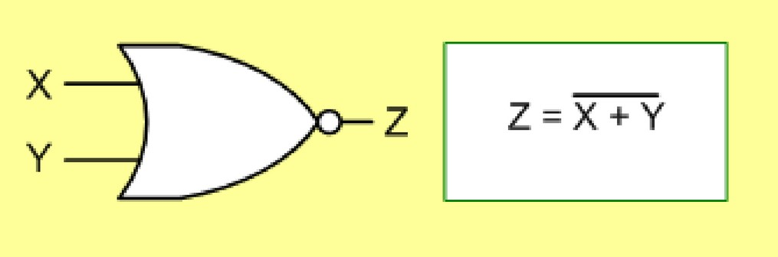
Nor Gate:
The NOR gate represents the complement of the OR operation. Its name is an abbreviation of NOT OR.
The graphic symbol for the NOR gate consists of an OR symbol with a bubble on the output, denoting that a complement operation is performed on the output of the OR gate.

Slide 13
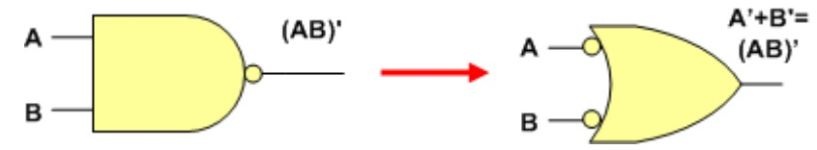
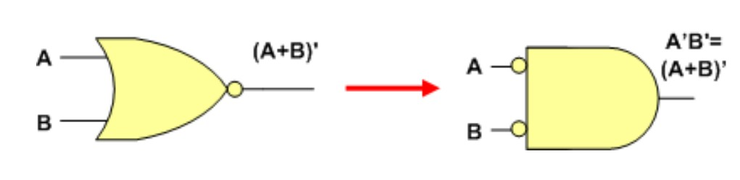
Equivalent Gate:
An equivalent gate, in digital logic, refers to a logic gate that performs the same Boolean logic function as another gate.
For example, a NAND gate is equivalent to an AND gate followed by a NOT gate, and a NOR gate is equivalent to an OR gate followed by a NOT gate.

Slide 14




















Usages of Universal Gate:
Standardization of Circuits
Simplification of Circuits
Design Flexibility
Education
Research

Slide 15



Number System
What is Number System ?
Types of Number System
Non-positional number system
Positional number system

Slide 16


Non-positional number system
Positional number system
Discussion about non-positional Number .
Example:-
The roman number system. i , ii, x, xi, L etc
What is positional Number ?
Example:-
1 , 3 , 9F,
1oo1 , 54.67 etc .

Slide 17
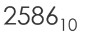
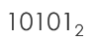

Positional number system
4 types of positional number system
DECIMAl NUMBEr SysTEM
10 unique symbols
0,1,2,3,4,5,6,7,8,9
01
BINAry NUMBEr SysTEM
2 unique symbols
0 , 1
02
OCTAl NUMBEr SysTEM
8 unique symbols
0,1,2,3,4,5,6,7
03
HEXADECIMAl NUMBEr
SysTEM
16 unique symbols
0, 1, 2, 3, 4, 5, 6, 7, 8, 9, A, B, C, D, E,F
04

Slide 18

Other Numbers to Decimal Number Convertion process
REMEMBER THIS 5 STEPS:-
Identify base of the given number.
Determine the column Value .
Starting from the rightmost digit, multiply each digit by its corresponding place value.
The decimal equivalent is the final result.
Calculate the sum of these products.

Slide 19
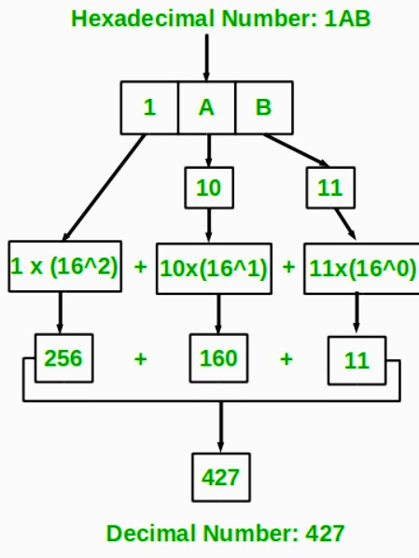
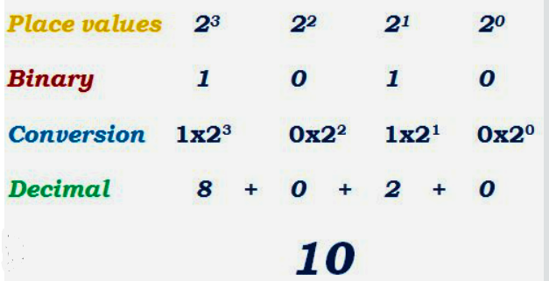


OTHER NUMBERS TO DECIMAL NUMBER CONVERT (EXAMPLE)
Binary value = 1010

Slide 20


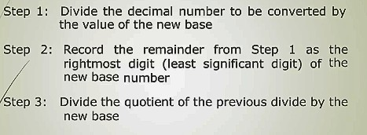


Converting a Decimal Number to a Number of Another Base
Division-Remainder Method

Slide 21
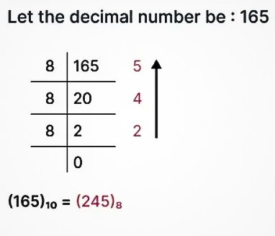
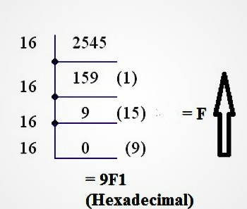

DECIMAL NUMBER
TO A NUMBER OF ANOTHER BASE (EXAMPLE)
Decimal = 2545
octal

Slide 22
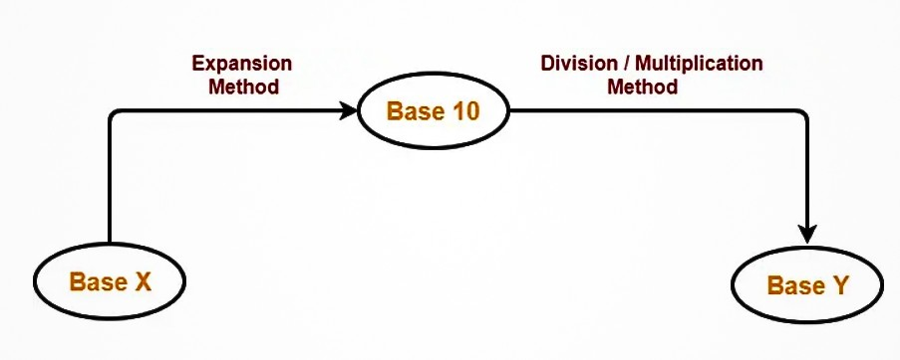
CONVERT ANY BASE TO
ANOTHER BASE
Here we can use only 2 steps .

Slide 23
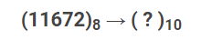
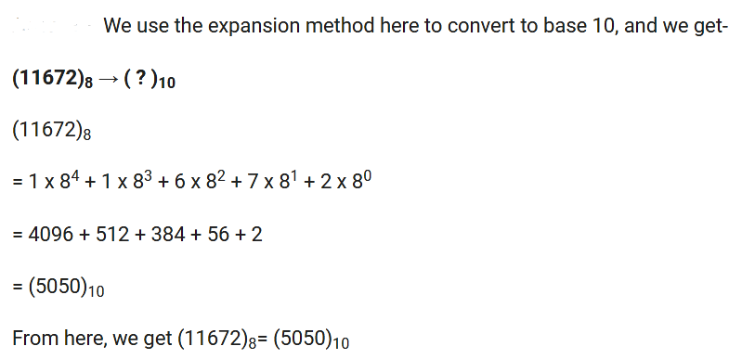
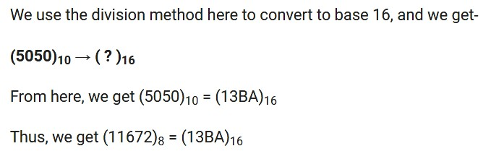
Convert any base to Another Base (Example)

Slide 24


Adder
An adder is a fundamental digital
circuit that performs the arithmetic operation of addition.
Two Type Off Adder-
Half-adder Full-adder

Slide 25

Half-Adder
In digital electronics, "half adder"
refers to a basic circuit that adds two binary digits
together.

Slide 26
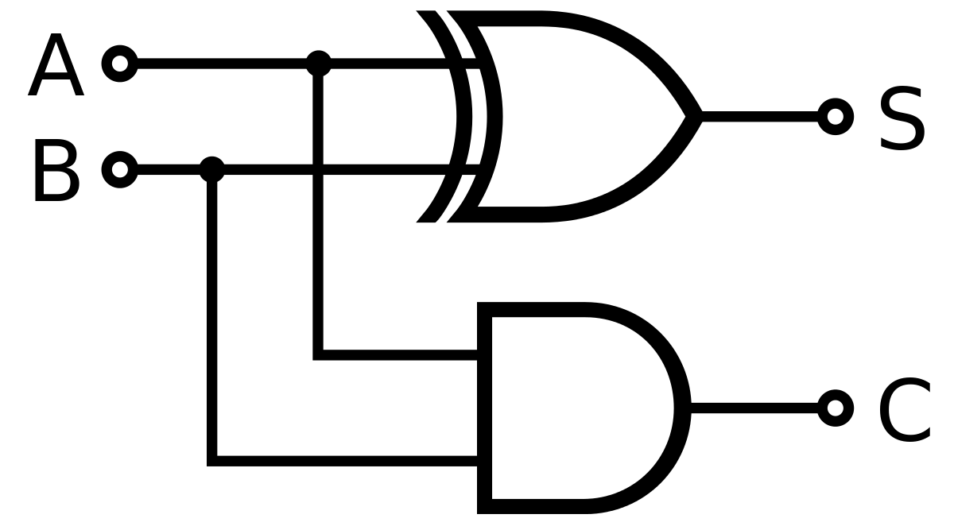
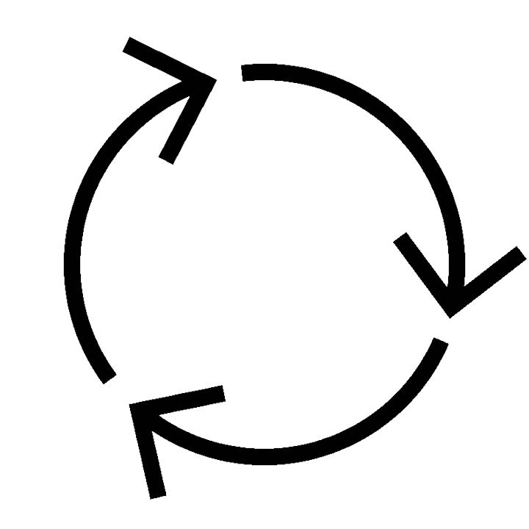

Circuit diagram
The sum output (S) represents the result of the addition of A and B, and it is calculated using the XOR (exclusive OR) gate.
The carry output (C) indicates if there is a carry-over from the addition, and it is determined using the AND gate.

Slide 27
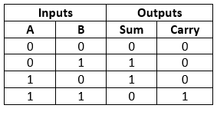
Truth Table

Slide 28


Adder (Full-adder)
Defination :
A full adder is a digital circuit that performs addition.
A FULL ADDER CIRCUIT, ON A BASIC LEVEL, IS USED TO ADD 3 BITS TO GIVE THEIR SUM AND A CARRY.

Slide 29
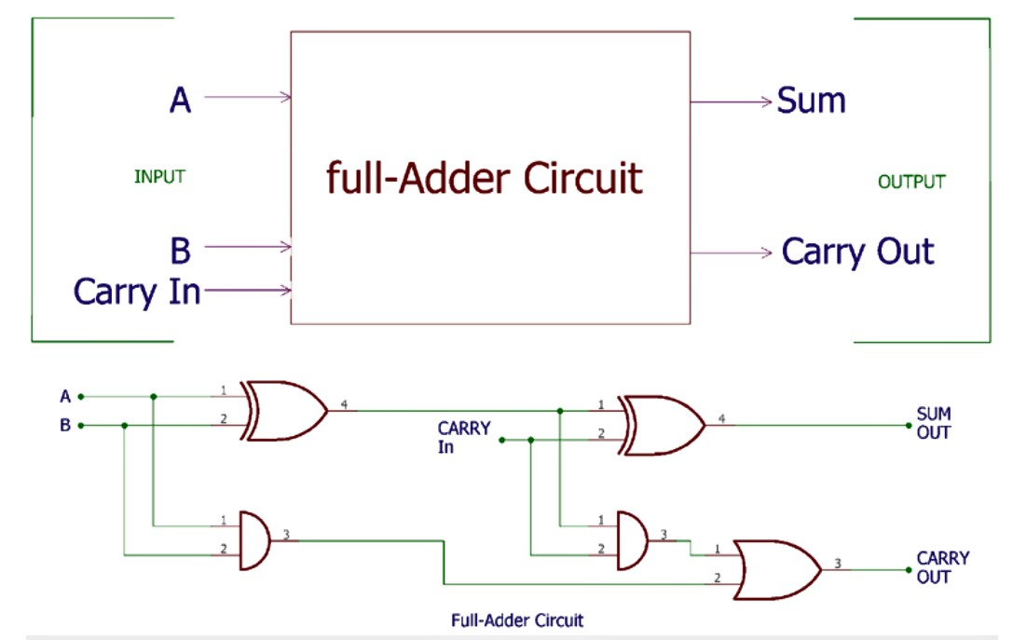
Circuit diagram

Slide 30
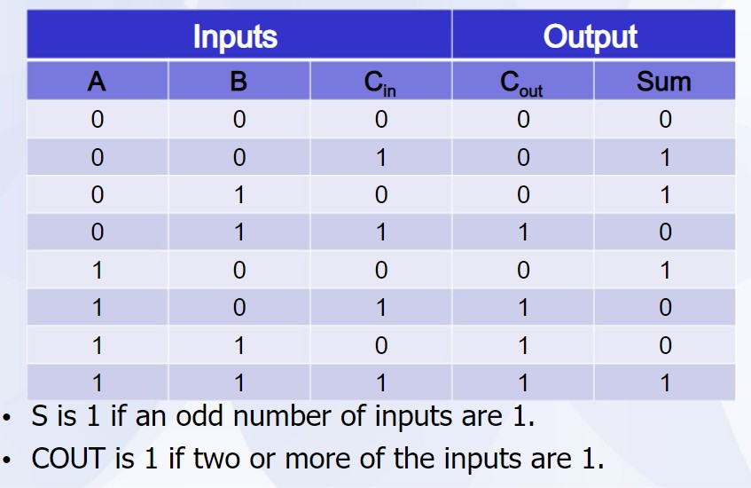
Truth Table

Slide 31

Advantage and disadvantage of full adder
The advantages are full swing output, low power consumption, high speed and robustness to supply voltage scaling, transistor sizing .
The disadvantage is that when used in a chain structure such as a ripple adder, the output drive capability is reduced.

Slide 32

Why do we use full adder
instead of half adder?
There is a primary difference between half adder and full adder. Half adder only adds the current inputs as 1-bit numbers and does not focus on the previous inputs. On the other hand, Full Adder can easily carry the current inputs as well as the output from the previous additions.

Slide 33
Thank you!
Have a good
Day !

